Slide 1
SAH Furniture
Notes:
san

Slide 2

Company Background & Business Challenges
SAH Furniture is a local Egyptian furniture manufacturer specializing in bedroom sets such as beds and wardrobes.
The company faces a lack of integration between departments such as Sales, Manufacturing, Inventory, and Procurement.
Sales teams struggle to communicate customized client requirements (like material choices or photos) to the production team.
Raw material availability often delays production due to a lack of automated procurement.
Currency fluctuations make raw material costing unstable, impacting profitability.
There is no visibility or documentation for quality checkpoints or customer approvals before final delivery.

Slide 3
ERP Solution Overview
Odoo 18 will be used to centralize all departments into one integrated system.
Sales Orders will automatically trigger Manufacturing Orders and Purchase Orders.
Bills of Materials (BoMs) define the exact structure and cost of products, including semi-finished components.
Quality checkpoints will be used to take photos during assembly and finishing stages, helping secure customer approvals.
Cost centers and foreign currency entries will ensure accurate profitability tracking.
Workflow automation will reduce manual errors and speed up decision-making.

Slide 4
Project Goals
Deliver a working Odoo 18 demo for a real-world furniture manufacturing company.
Simulate the full production flow of a bedroom set (bed + wardrobe) from sales to delivery.
Use actual Egyptian market data for raw materials like wood, fittings, and paints.
Track the full product lifecycle: from Quotation → Sales Order → Manufacturing → Quality → Delivery.
Showcase full integration between the Sales, Manufacturing, Purchase, Inventory, and Accounting modules.

Slide 5
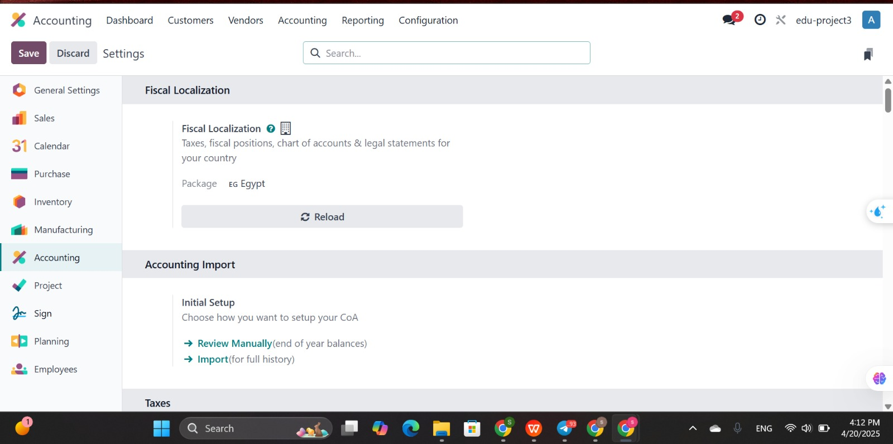

Slide 6
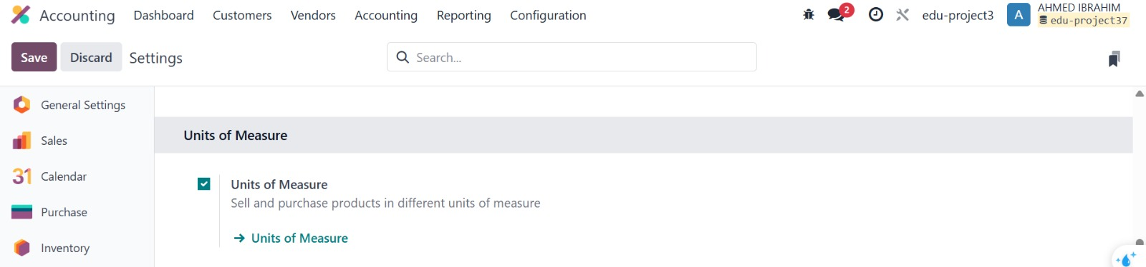

Slide 7
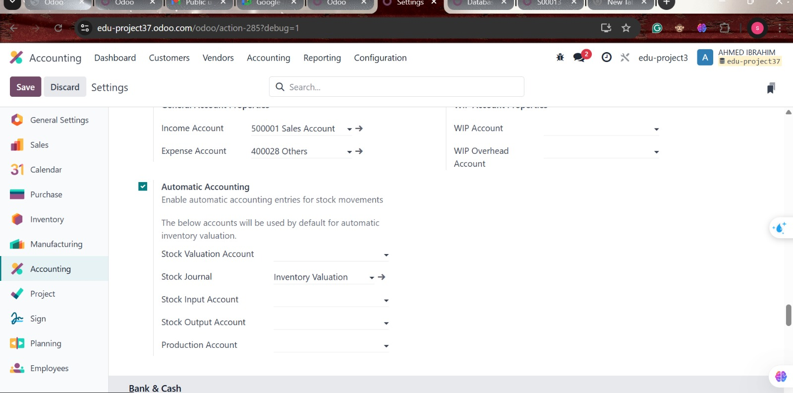

Slide 8
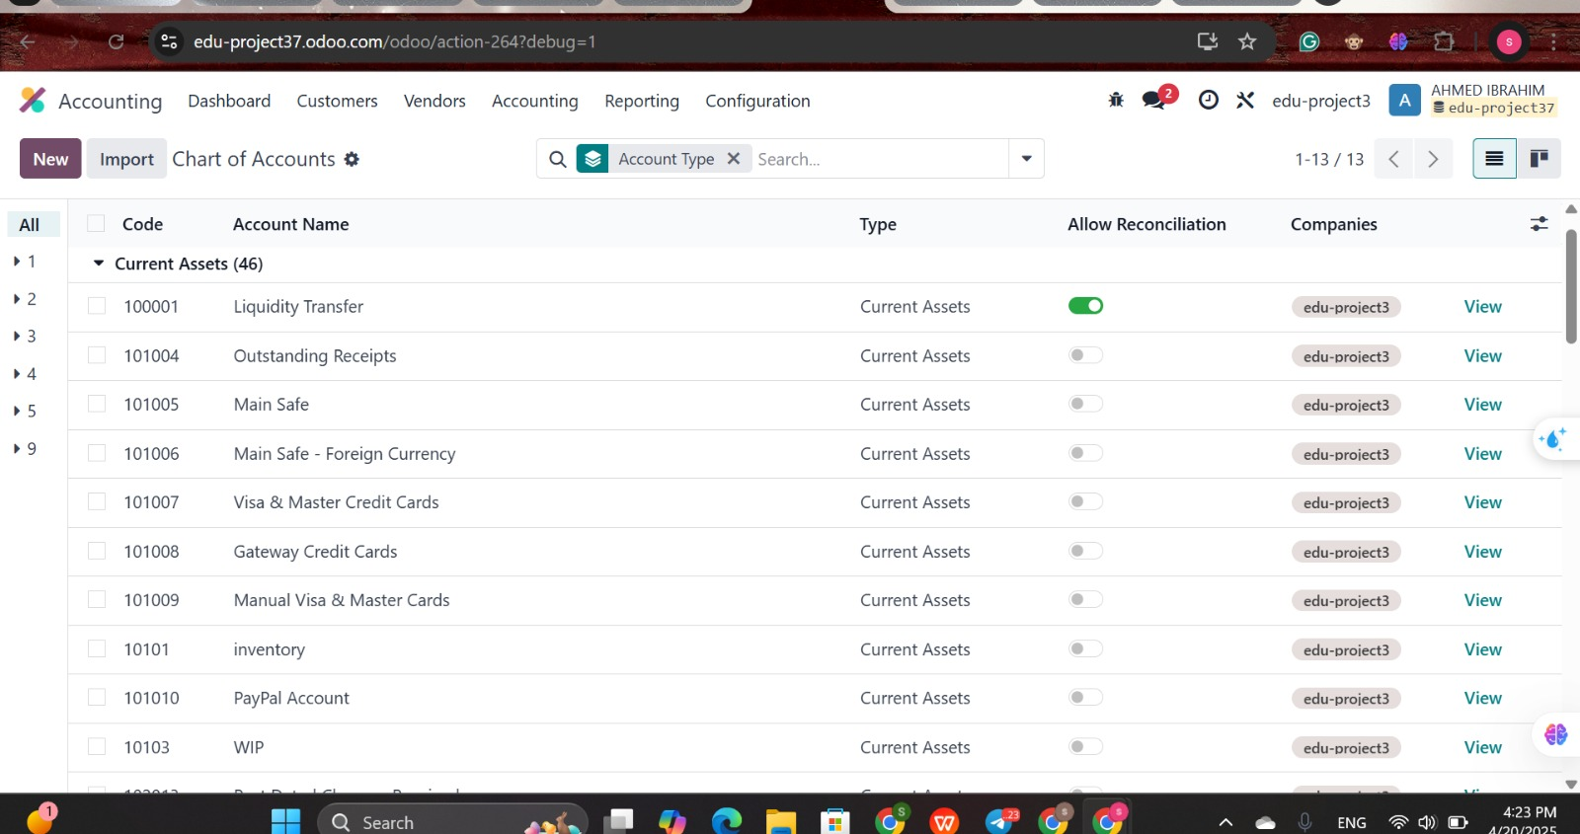

Slide 9
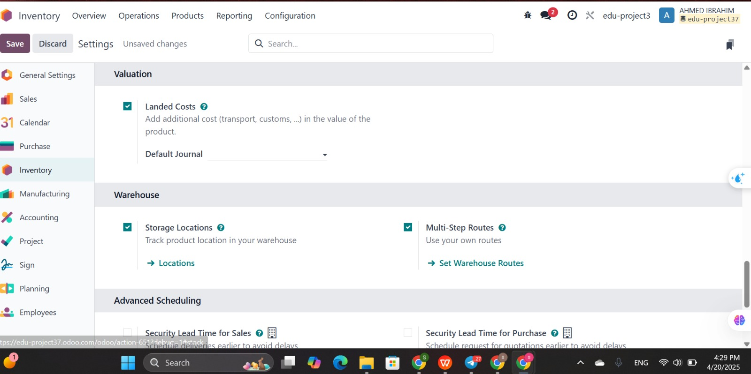

Slide 10
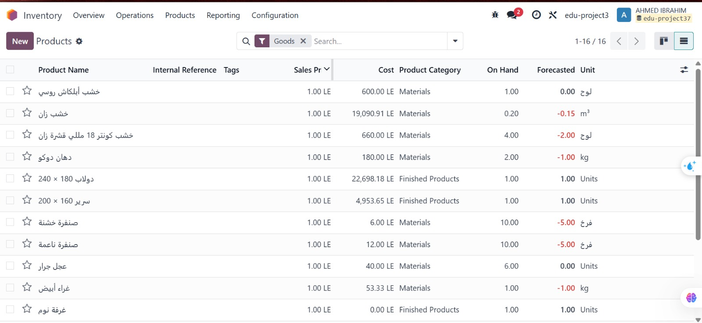

Slide 11
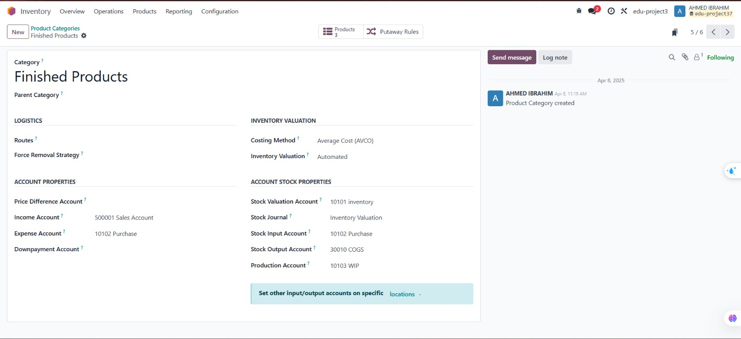

Slide 12
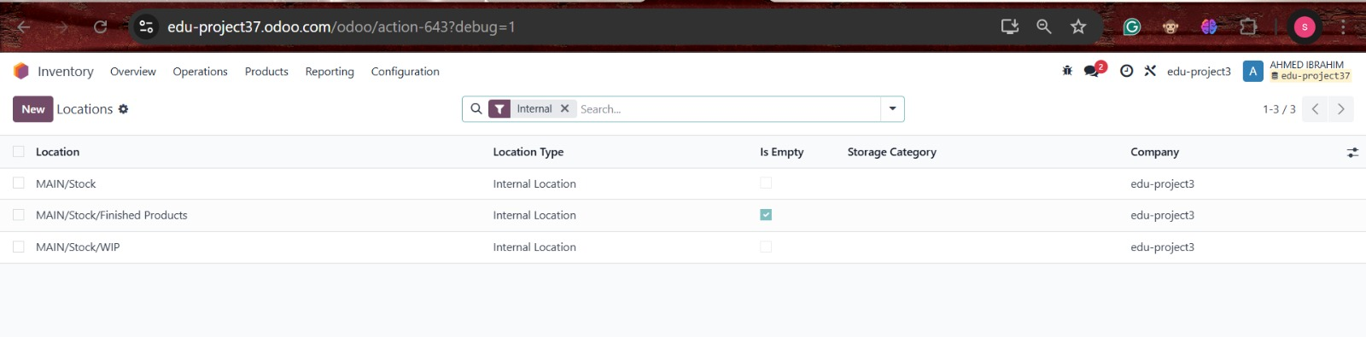

Slide 13
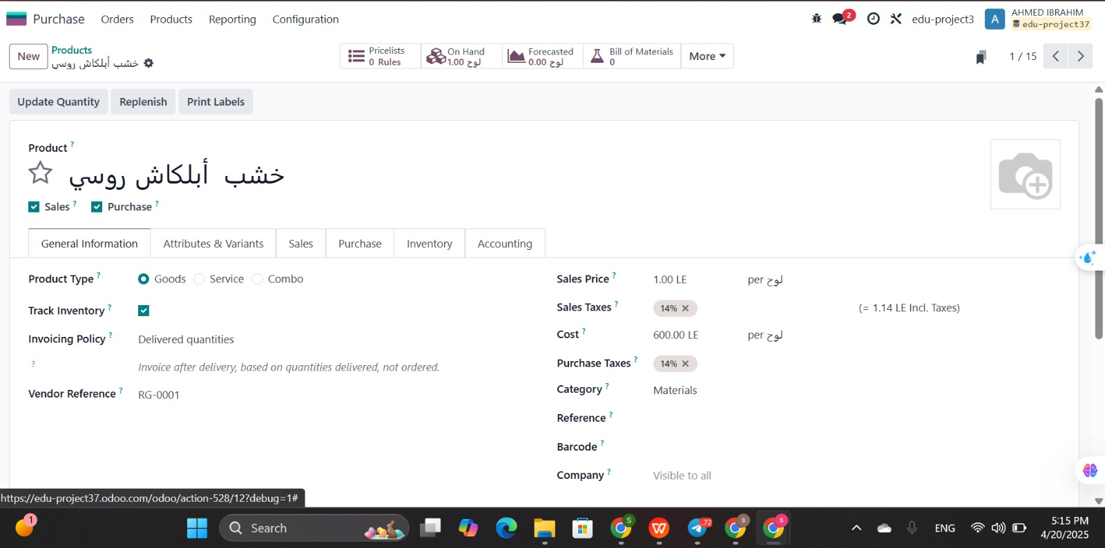

Slide 14
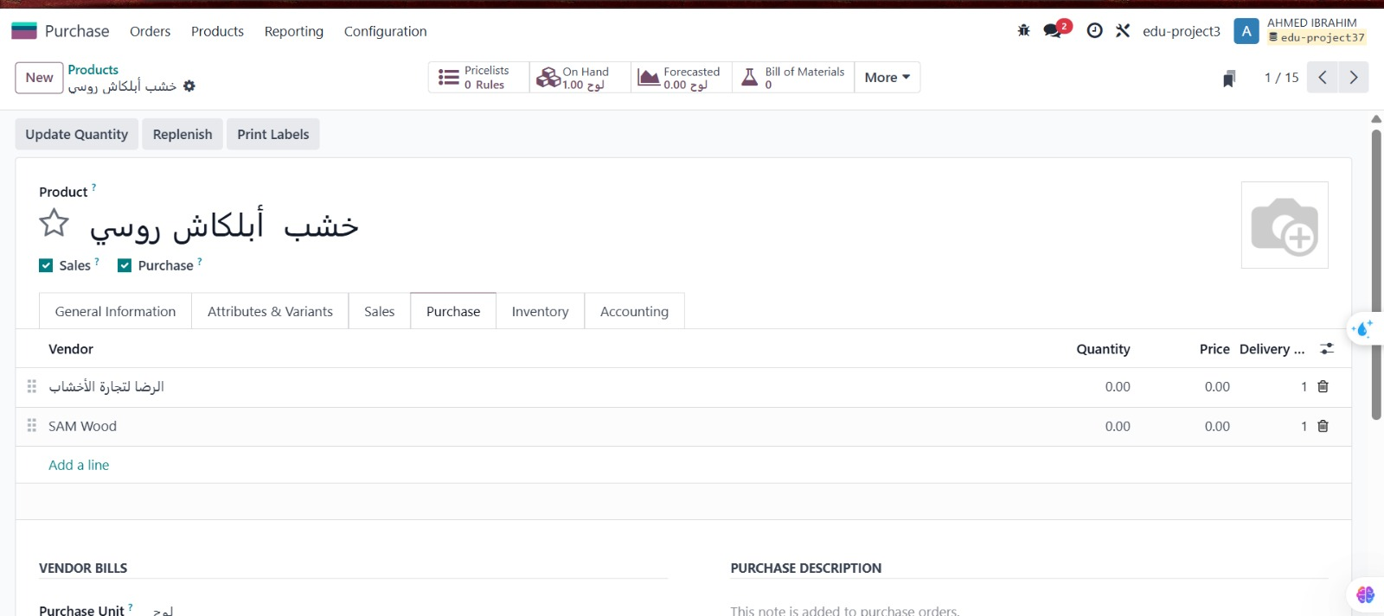

Slide 15
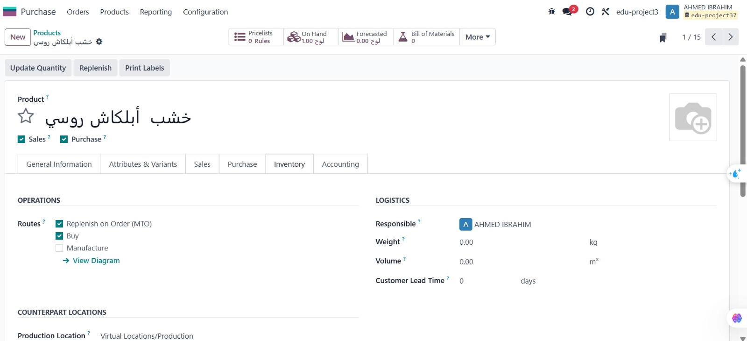

Slide 16
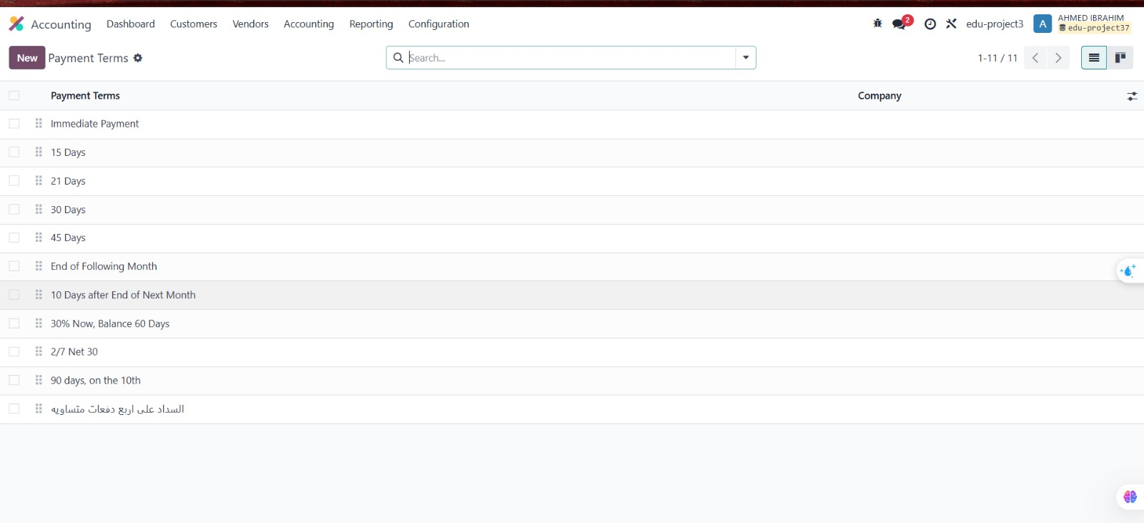
Notes:
لاننلال

Slide 17
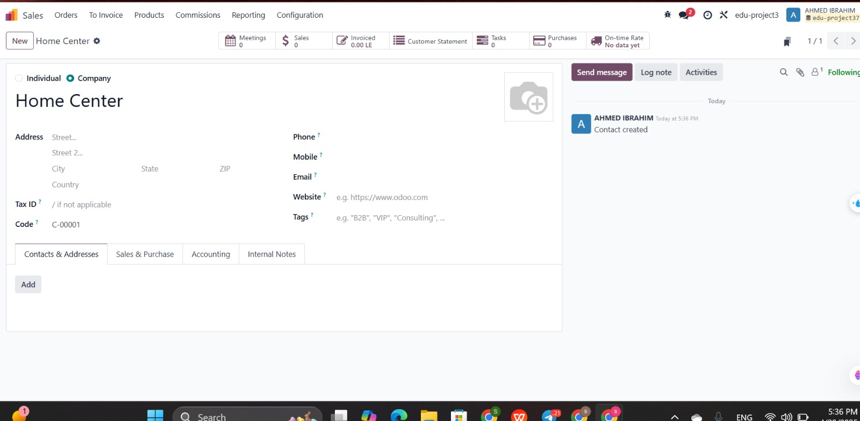

Slide 18
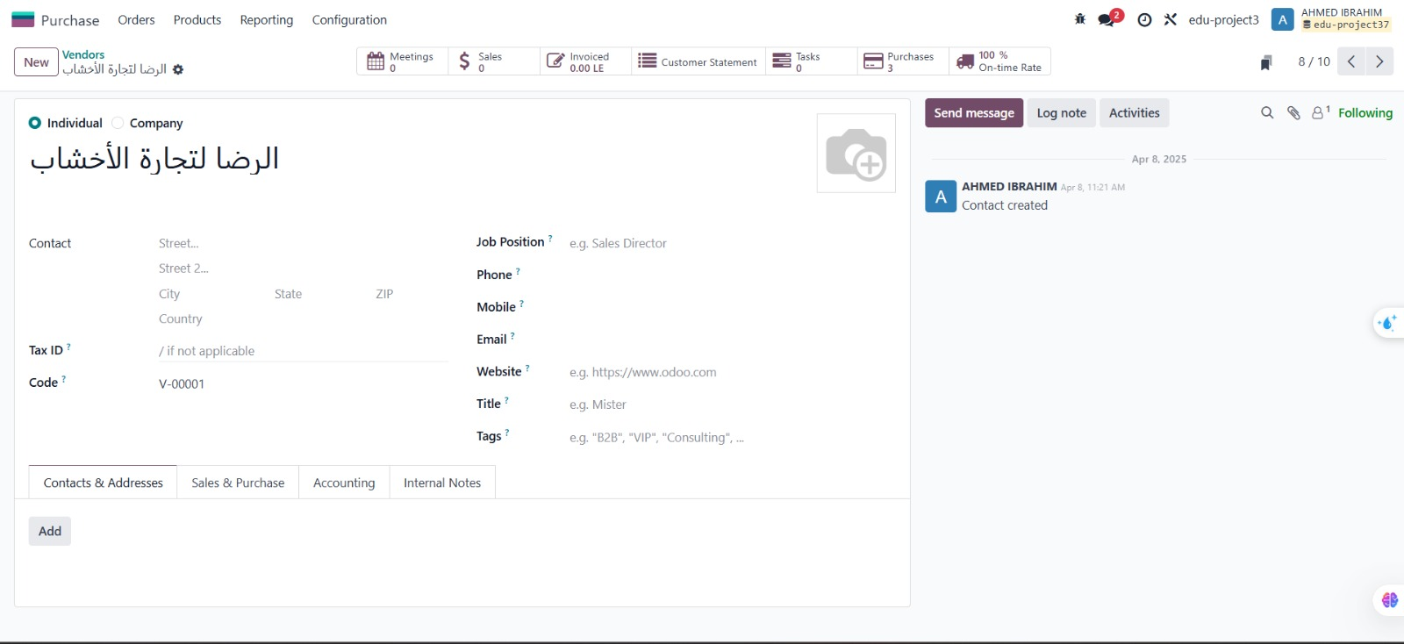

Slide 19
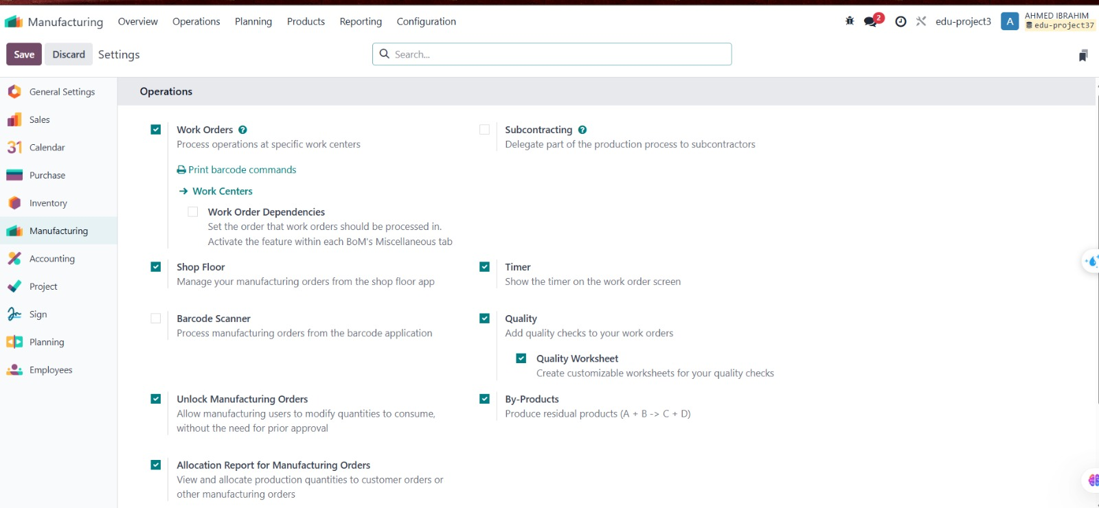

Slide 20
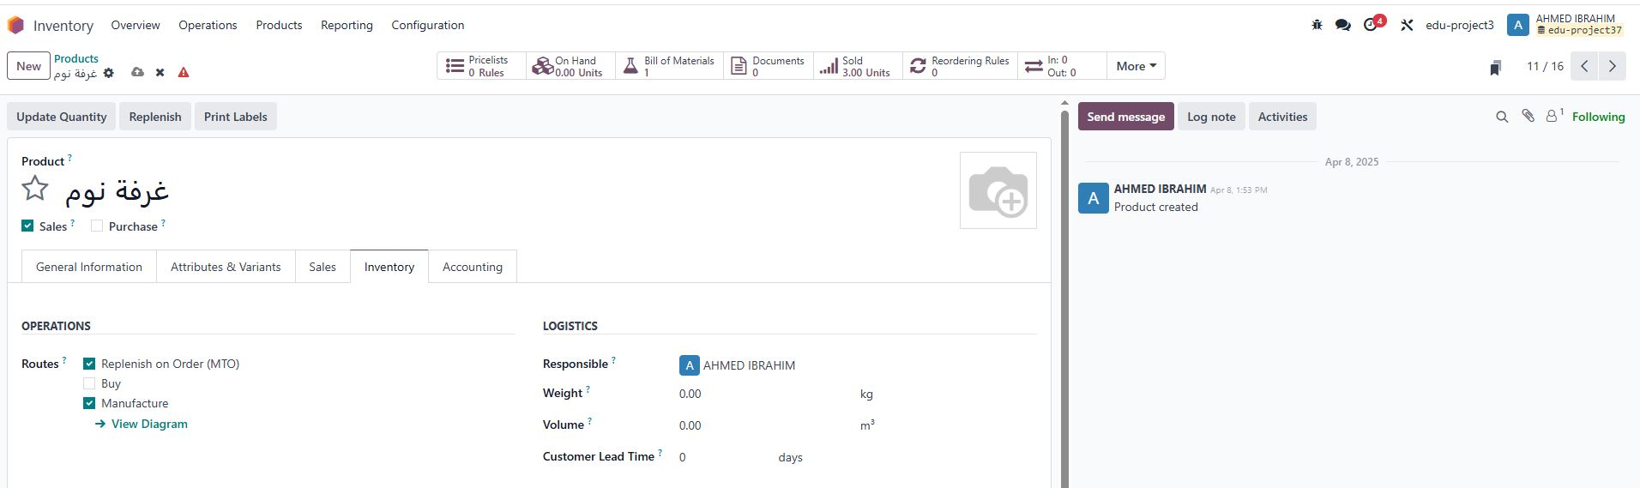
تم تفعيل خيار Replenish on Order (MTO) مع تفعيل خيار Manufacture لعمل Automatic Moعند عمل Sales Order لهذا المنتج

Slide 21
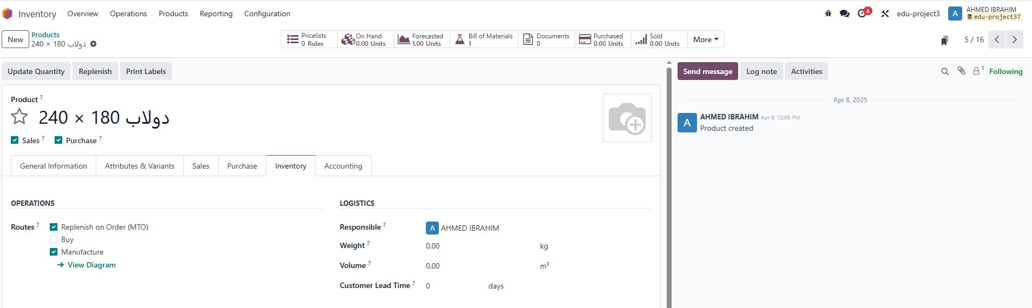
تم تفعيل خيار Replenish on Order (MTO) مع تفعيل خيار Manufacture لعمل Automatic Moعند عمل Sales Order لهذا المنتج

Slide 22
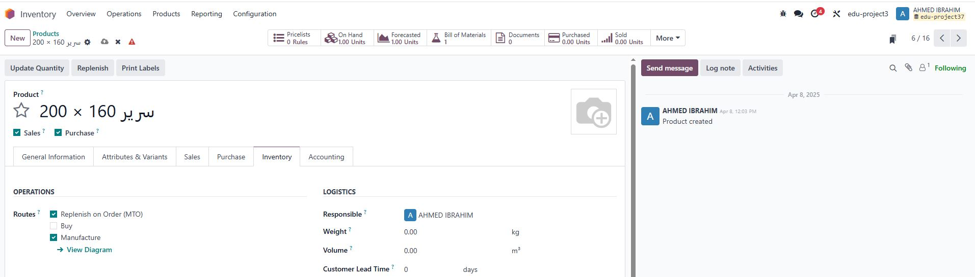
تم تفعيل خيار Replenish on Order (MTO) مع تفعيل خيار Manufacture لعمل Automatic Moعند عمل Sales Order لهذا المنتج

Slide 23
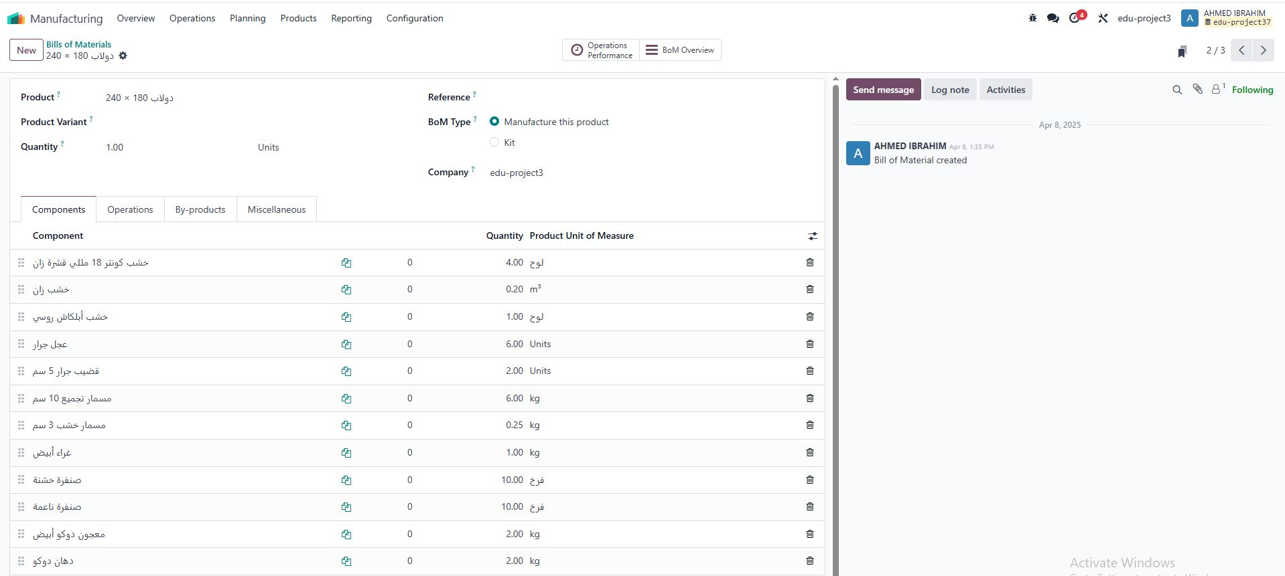
إضافة قائمة المواد الخام التي يتكون منها المنتج المراد تصنيعه والتي تم الحصول عليها من العميل

Slide 24


Slide 25
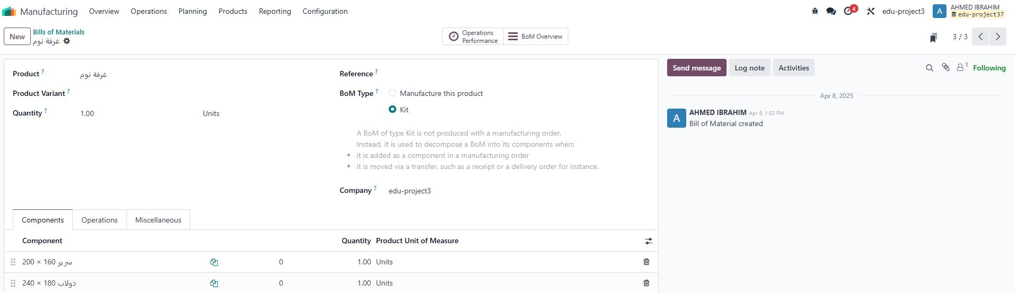

Slide 26
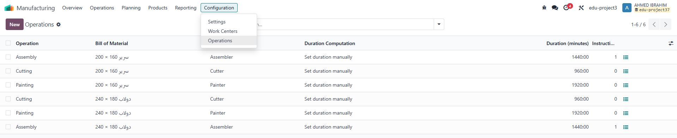
إضافة عمليات التصنيع والوقت الذي تحتاجه كل عملية

Slide 27
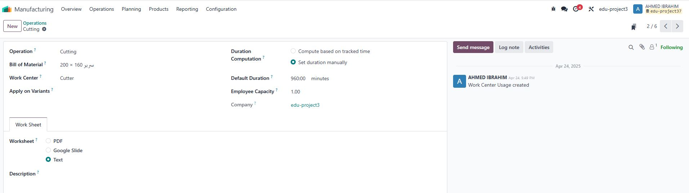

Slide 28
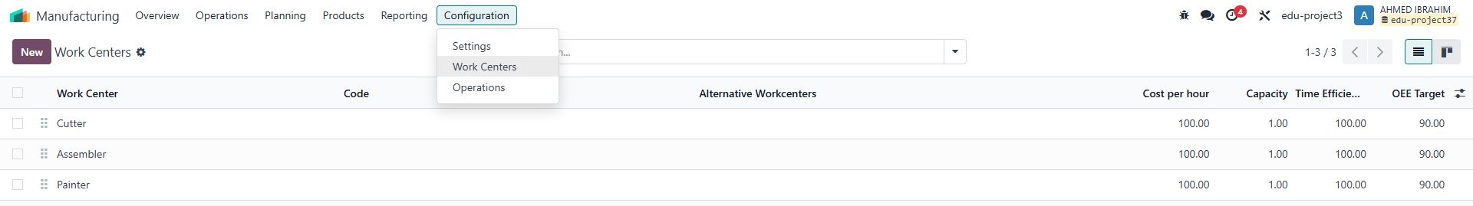
إضافة مراكز التصنيع أو الآلات

Slide 29
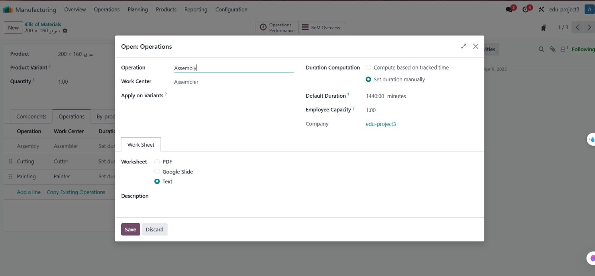

Slide 30
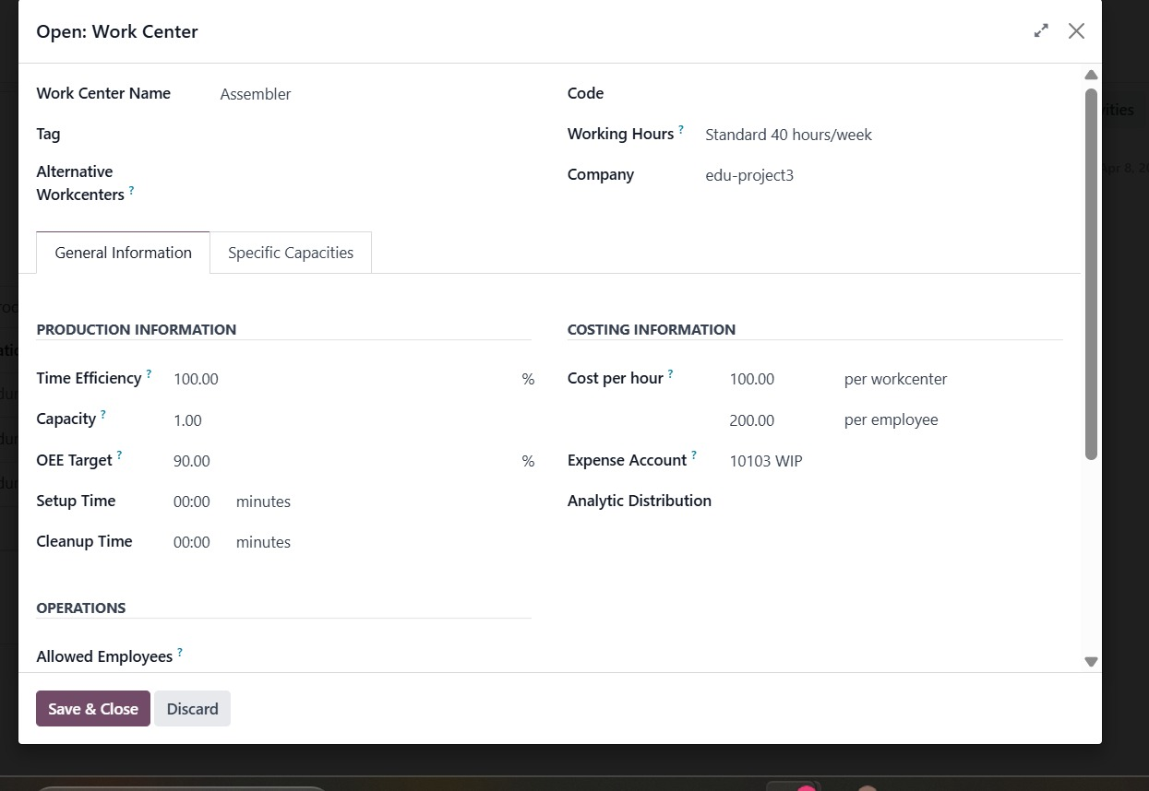

Slide 31
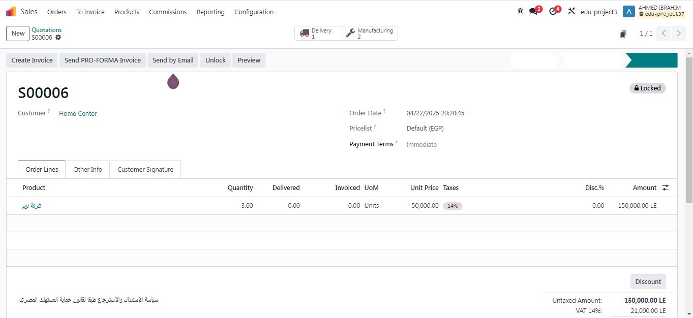

Slide 32
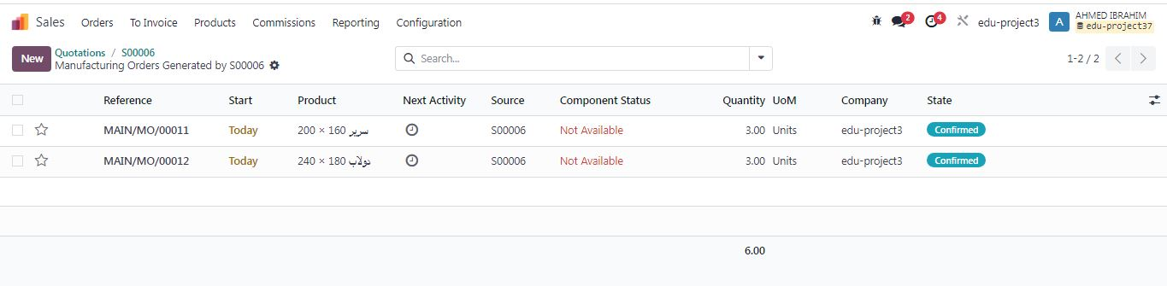

Slide 33
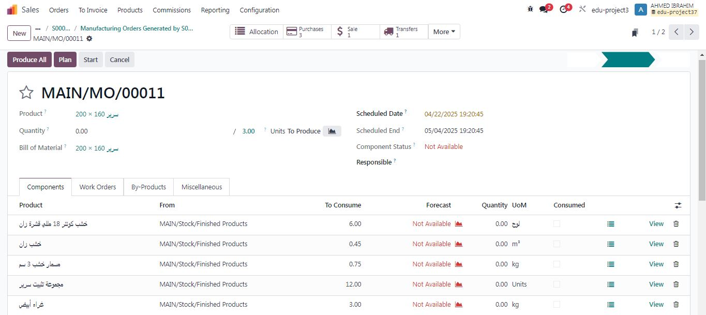

Slide 34
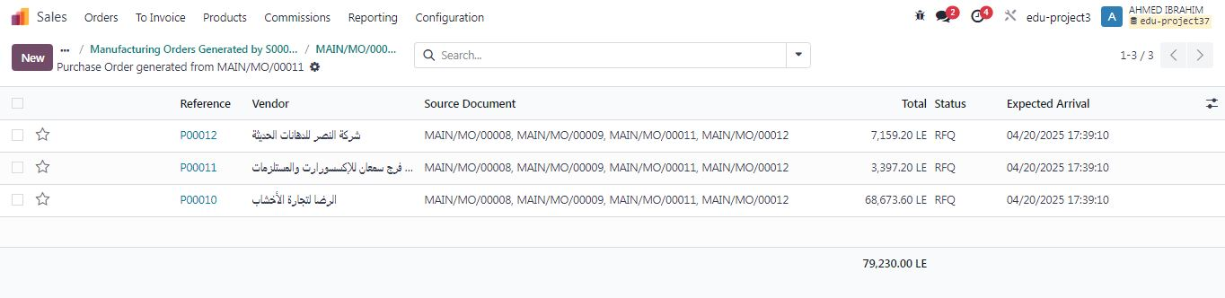

Slide 35
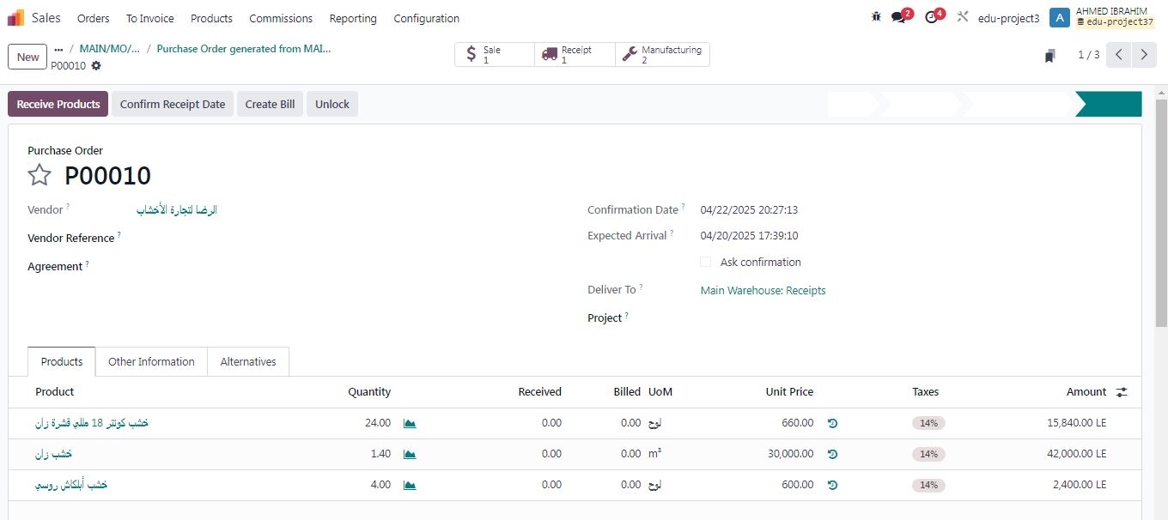

Slide 36
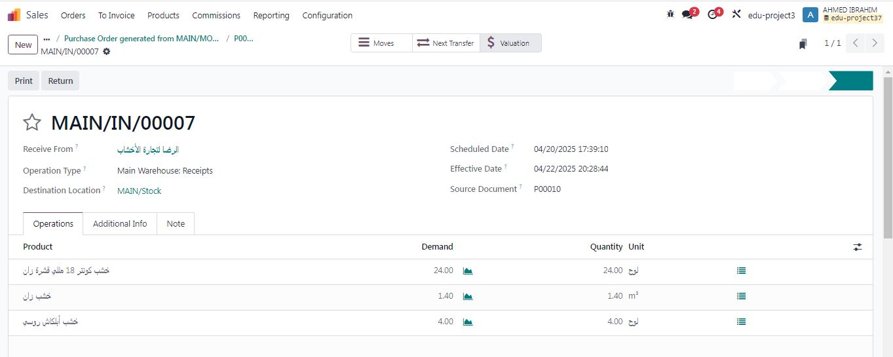

Slide 37
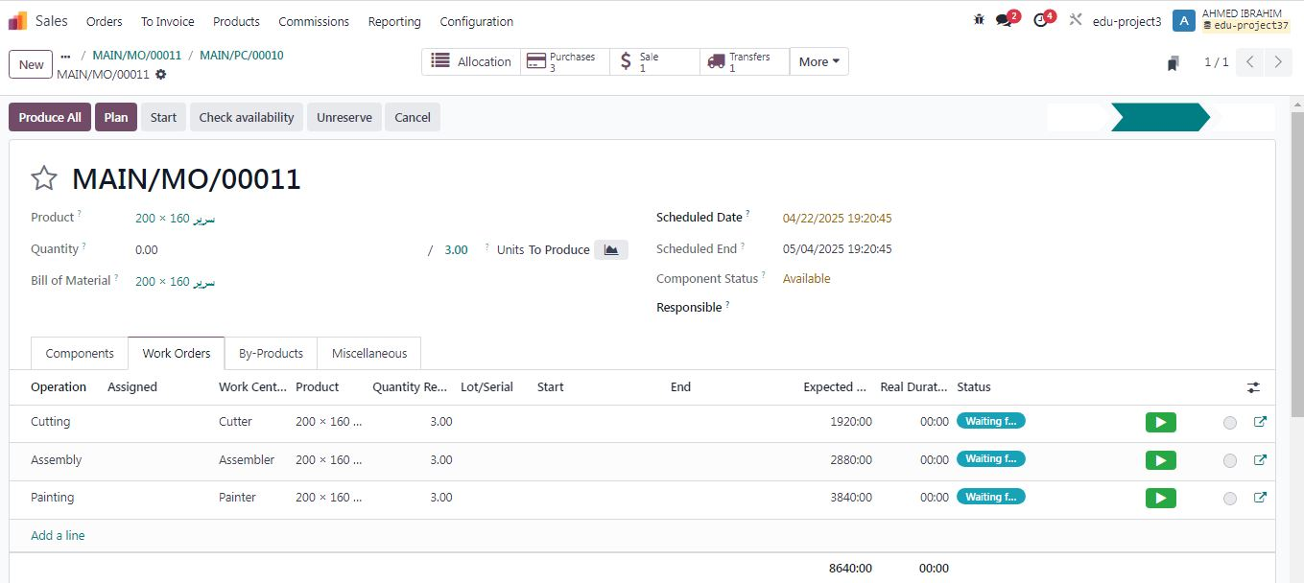

Slide 38
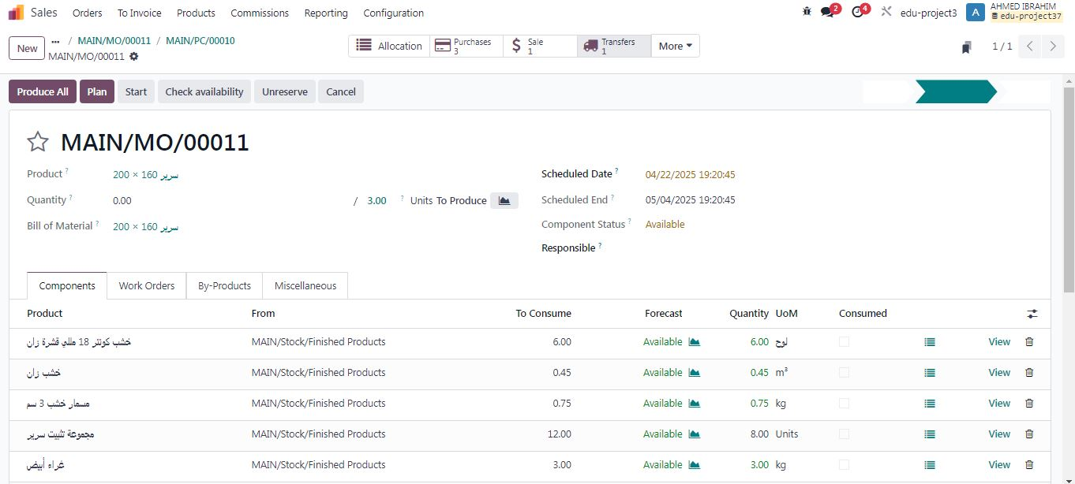

Slide 39
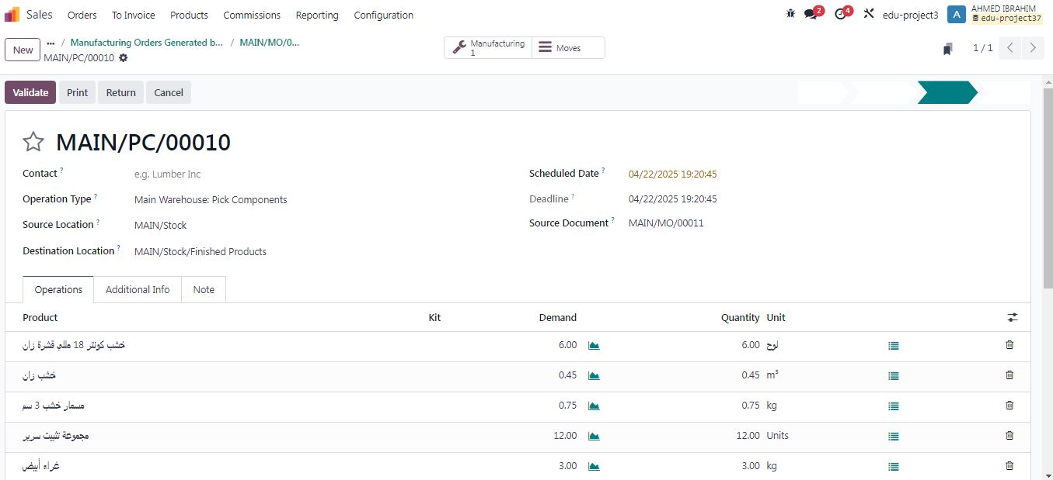

Slide 40
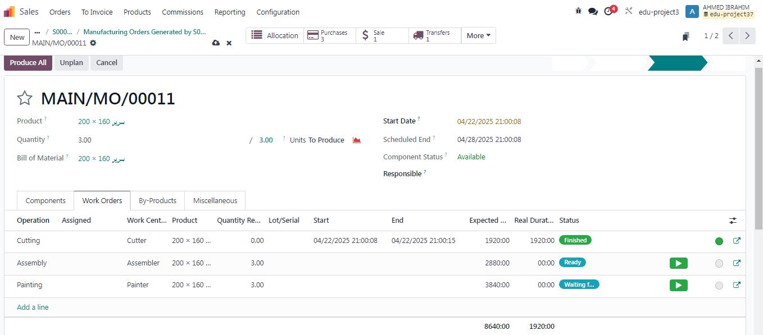

Slide 41
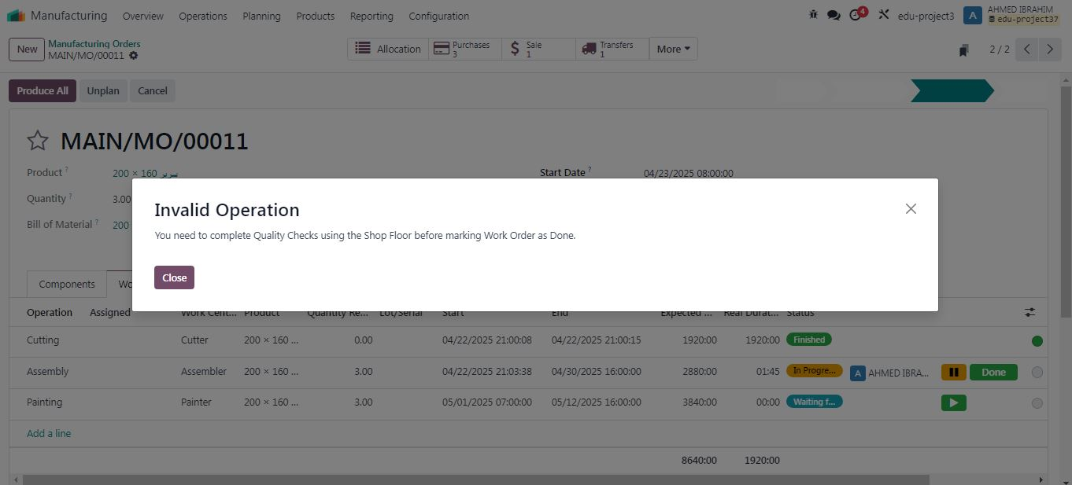

Slide 42
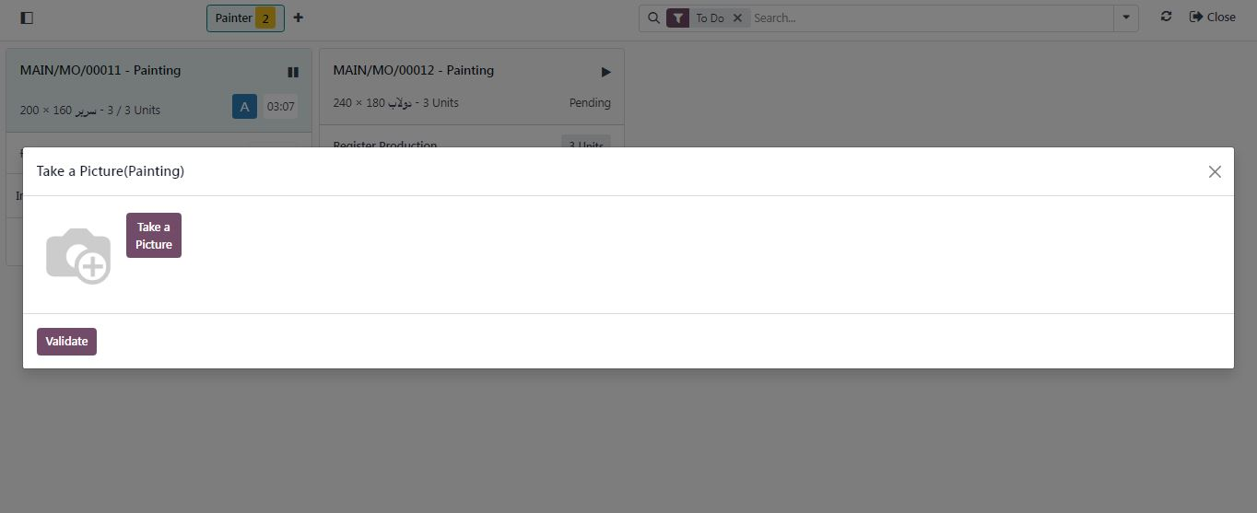

Slide 43
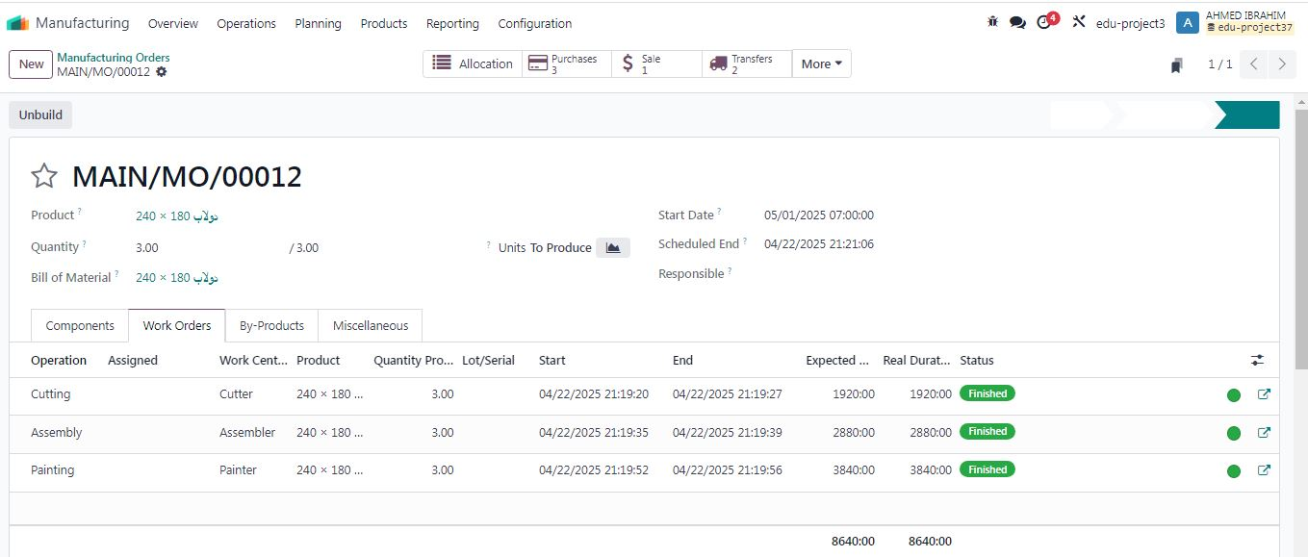

Slide 44
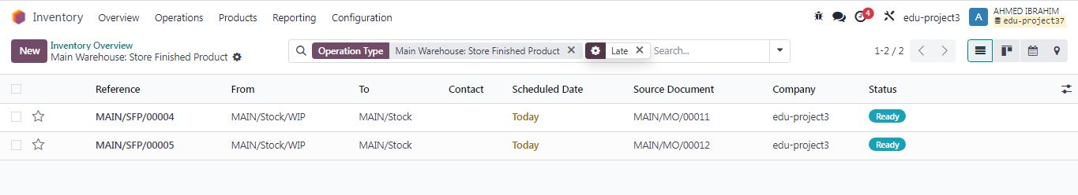

Slide 45
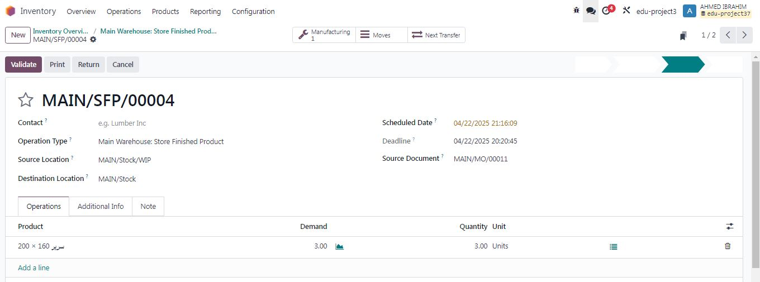

Slide 46


Slide 47
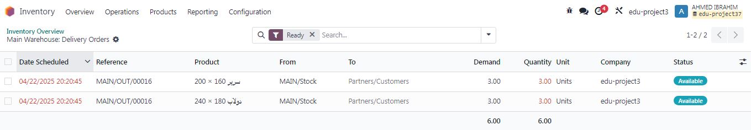

Slide 48
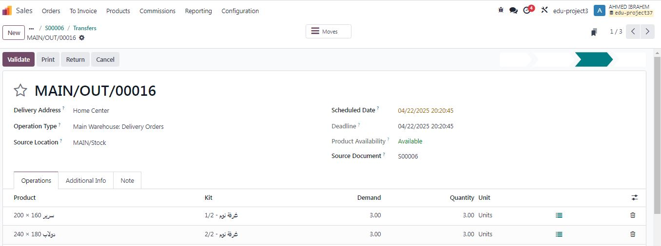

Slide 49
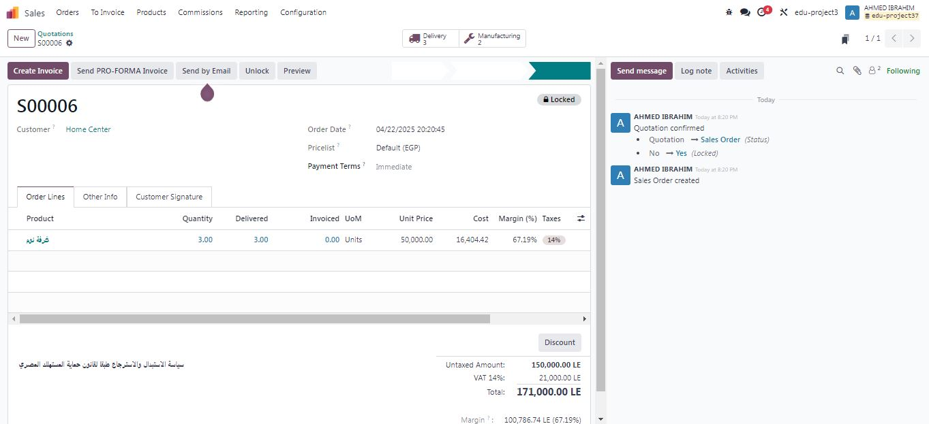

Slide 50
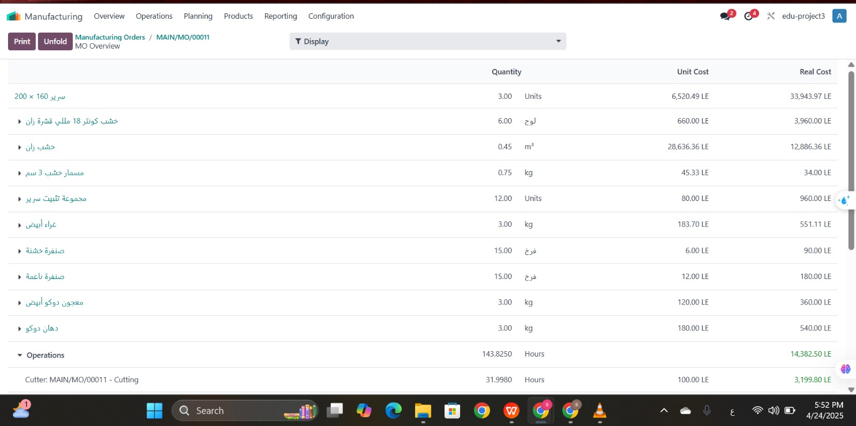

Slide 51
